Slide 1
NIH Funding Analysis Project
Compiled By- Ritik Bhardwaj

Slide 2
Introduction
This project analyzes NIH dataset to understand yearly funding patterns, research area funding distribution, and identify top funded areas. The dashboard provides interactive insights for data-driven decisions.

Slide 3
Key Findings
• Heart Disease receives the highest cumulative funding.
• Sharp rise in funding after 2015.
• Stable upward trend for major diseases.
• Certain research areas show underfunding despite prevalence.

Slide 4
Methodologies
• Data cleaning in Excel.
• Pivoting dataset in Tableau for Year & Funding.
• Calculated fields: Year_clean.
• Created bar charts, heat maps, and trend graphs.
• Built an interactive dashboard.

Slide 5
Approaches
• Bottom‑up data cleaning.
• Field transformations for proper data types.
• Trend analysis using SUM(Funding).
• Visual comparison across research categories

Slide 6
Actionable Insights
• Allocate funds to underfunded but high‑impact disease categories.
• Increase monitoring on rapidly rising funding areas.
• Improve transparency in research area growth patterns.

Slide 7
Insights / Trends
• Consistent funding growth from 2015–2024.
• Heart Disease & Cardiovascular research dominate funding.
• Several rare diseases receive minimal funding.

Slide 8
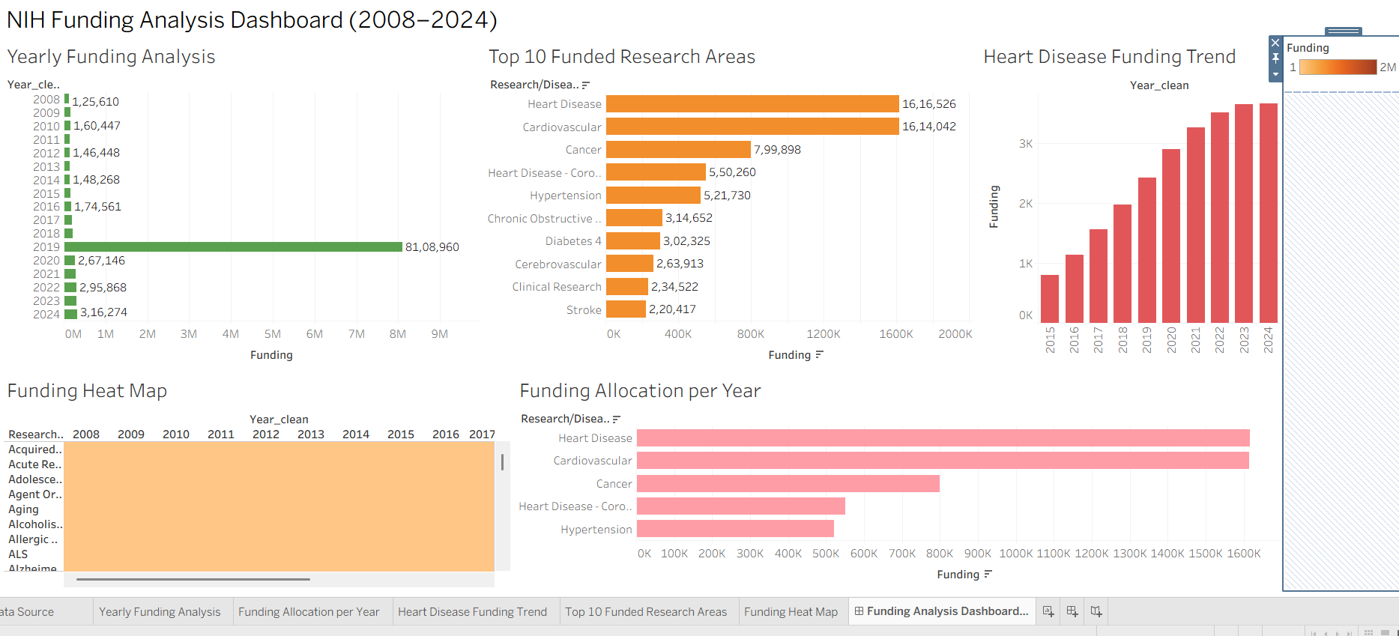
Dashboard

Slide 9
Conclusions
NIH funding demonstrates predictable trends with key high‑priority research areas receiving consistent support. Additional funding diversification can improve equity across disease categories.

